Slide 2
Introduction & Entry Plan
Your Name Here

Slide 3
Professional Experience
Principal, Olympic View Elementary, 2008-2012
Head Teacher, John Hay Elementary, 2006-2008
6th-7th grade science teacher, Aki Kurose Middle School, 2002-2006

Slide 4
Education & Certification
Ph.D., Educational Leadership & Policy, University of Washington, 2018
Principal Certification, Danforth Program for Educational Leadership, University of Washington, 2007
M.Ed. Curriculum & Instruction, Seattle University, 2006
B.A. Science Education, Harding University, 2002

Slide 5
Family & Personal Life

Slide 6
What Recharges Me
Hiking
Reading
Journaling
UW Husky Football

Slide 7
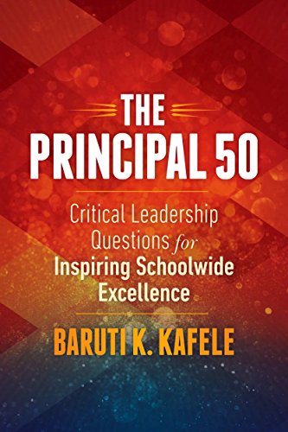
Books I’ve Recently Enjoyed

Slide 8
By Day 30
Send introductory letter to parent community
Meet-and-greet with students
Meet individually with all staff members
Meet individually with key central office staff
Complete hiring for all vacant positions

Slide 9
By Day 60
Meet with 12-month school staff including head secretary, custodian, and admin team to prepare for the new year
Plan back-to-school staff development
Send back-to-school parent letter
Plan Open House

Slide 10
By Day 90
Welcome staff back to campus
Engage in collective professional learning
Develop theme & shared commitments for the year
Finalize preparations for opening of school
Welcome families to Open House

Slide 11
Day 100 and Beyond
Greet students at new student orientation
Greet students on the first day of school
Conduct welcome-back assembly first week of school
Plan & host Curriculum Night

